Slide 1
Modules:- creating custom modules Math.js result.js result.js
function add(a,b) { return a+b; }
const math=require("./math"); console.log(add(2,3));
This is going to hit ReferenceError: add is not defined
It will give { } as a result. Because this add function is private currently we need to export this to use it publicly.
const math=require("./math"); console.log(math);

Slide 2
Modules:- Math.js result.js output Math.js result.js output
function add(a,b) {
return a+b;
}
module.exports=add;
const math=require("./math"); console.log(math);
//Console.log(math(2,3);
->[Function: add]
-> 5
function add(a,b) {
return a+b;
}
function sub(a,b) {
return a-b;
}
module.exports=add;
module.exports=sub;
Result is:
-1
Reason:
module.exports=sub;
It is overwriting
(incorrect way)
const math=require("./math"); Console.log(math(2,3);

Slide 3
->For previous overwriting problem we can refer to Js object to return multiple things we can refer it is Default Export Math.js result.js output:- { add: [Function: add], sub: [Function: sub] } output2:- 5 -5
function add(a,b) {
return a+b;
}
function sub(a,b) {
return a-b;
}
module.exports={add,sub};
const math=require("./math");
console.log(math);
console.log(math.add(2,3),math.sub(3,8));

Slide 4
Array destructuring Math.js result.js output :- 5 -5
function add(a,b) {
return a+b;
}
function sub(a,b) {
return a-b;
}
module.exports={add,sub};
const {add,sub}=require("./math");
console.log(add(2,3),sub(3,8));

Slide 5
Using Multiple Export output :- 5 -5
function add(a,b) {
return a+b;
}
function sub(a,b) {
return a-b;
}
exports.add =(a,b) => a+b;
exports.sub =(a,b) => a-b;
const {add,sub}=require("./math");
console.log(add(2,3),sub(3,8));

Slide 6
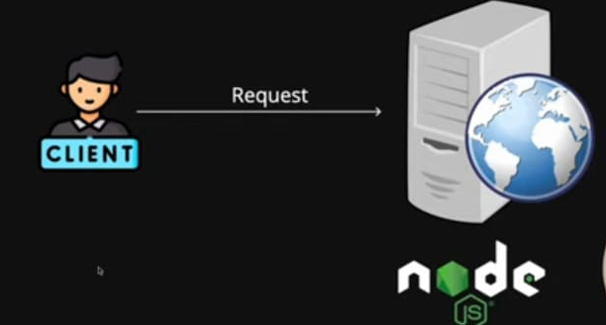
Node JS Architecture

Slide 7
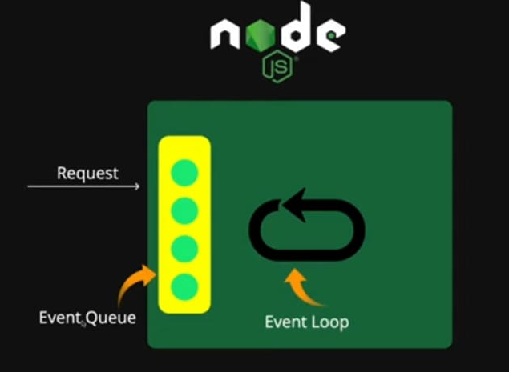
Node JS Architecture

Slide 8
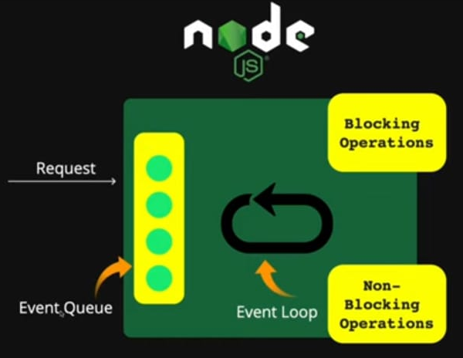
Node JS Architecture

Slide 9
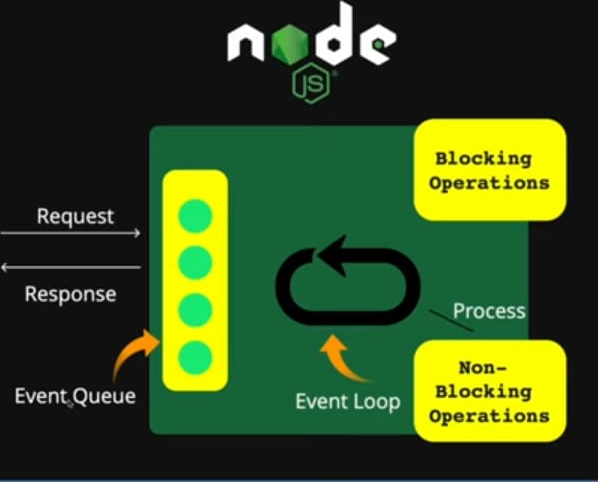
Node JS Architecture

Slide 10
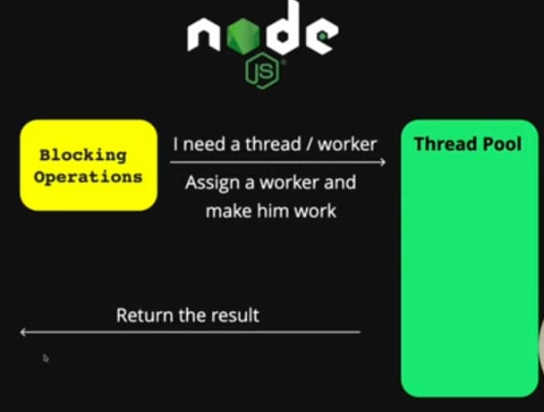
Node JS Architecture

Slide 11
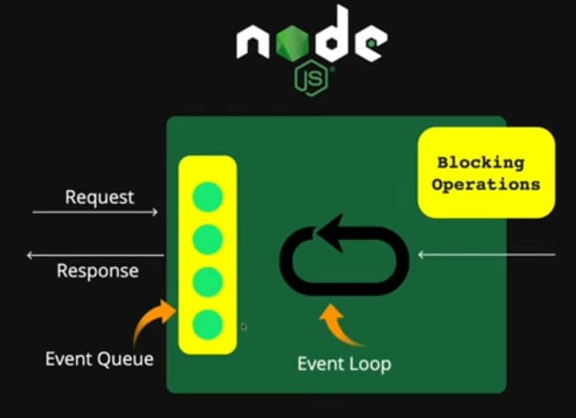
Node JS Architecture

Slide 12
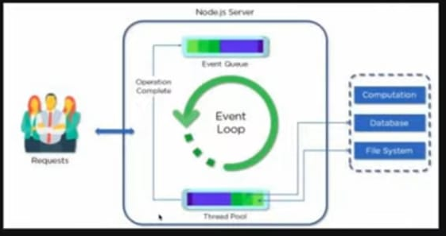
Node JS Architecture

Slide 13
For Blocking/Sync process testing.js output:- 1 hey this is sync 2
const fs= require("fs"); console.log("1"); const result=fs.readFileSync("contact.txt","utf-8"); console.log(result); console.log("2");

Slide 14
For Non- Blocking/ASync process testing.js output:- 1 2 hey this is sync console.log(os.cpus().length);
const fs= require("fs"); console.log("1"); fs.readFile("contact.txt","utf-8" , (err,result)=>{ console.log(result); }); console.log("2");

Slide 15
file System : FS module write content Asynchronously. :- (writeFile) here in this function we need to pass a function as an argument i.e., callback function that gets called when that task completes. The callback has an argument that tells you whether the operation completed successfully. Writefile.js output:- File has been created null
const fs= require("fs"); fs.writeFile("read.txt","Async filehandling",(err)=>{ console.log("File has been created"); console.log(err); });

Slide 16
file System Appending content Asynchronously. :- (appendFile) Writefile.js output:- content has been added null
const fs= require("fs"); fs.appendFile("read.txt"," new data is going to insert",(err)=>{ console.log("content has been added "); console.log(err); });

Slide 17
file System Read content Asynchronously. :- (readFile) here the content from read.txt is going to be a part of data argument & we can print the content by using data itself. readfile.js output:- <Buffer 68 65 6c 6c 6f 20 6e 65 77 20 64 61 74 61 20 69 73 20 67 6f 69 6e 67 20 74 6f 20 69 6e 73 65 72 74>
const fs= require("fs"); fs.readFile("read.txt",(err,data)=>{ console.log(data); });

Slide 18
file System Read content Asynchronously. :- (readFile) here the content from read.txt is going to be a part of data argument & we can print the content by using data itself. readfile.js output:- hello new data is going to insert
const fs= require("fs"); fs.readFile("read.txt","UTF-8",(err,data)=>{ console.log(data); });

Slide 19
OS System The os module provides operating system-related utility methods & properties. It can be accessed using :
const os = require(‘os’);
const os =require("os") console.log(os.arch()); const freeMemory=os.freemem(); //console.log(freeMemory); console.log(`${freeMemory / 1024 / 1024 / 1024}`); const totalmem=os.totalmem(); console.log(`${totalmem / 1024 / 1024 / 1024}`); console.log(os.hostname()); console.log(os.platform());
x64 0.8484535217285156 3.8539657592773438 DESKTOP-NHGO9UI win32

Slide 20
Path Module The path module provides utilities for wrking with file & directory ppaths. It can be accessed using
const os = require(‘path’);
const path = require("path") console.log(path.dirname("C:/Users/DELL/Desktop/Back-End/NodeJs/File-structure/path/file1.js")); console.log(path.extname("C:/Users/DELL/Desktop/Back-End/NodeJs/File-structure/path/file1.js")); console.log(path.basename("C:/Users/DELL/Desktop/Back-End/NodeJs/File-structure/path/file1.js")); //console.log(path.parse("C:/Users/DELL/Desktop/Back-End/NodeJs/File-structure/path/file1.js")); const par=path.parse("C:/Users/DELL/Desktop/Back-End/NodeJs/File-structure/path/file1.js"); console.log(par.name);

Slide 21
HTTP Module To access web pages of any web application,you need a web server. The web server will handle all the http requests for the web application e.g . IIS is a web server for ASP.NET web applications and Apache is a web server for PHP or java web application. Node.js provides capabilities to create your own web server which will handle HTTP requests asynchronously. You can use IIS or Apache to run Node.js web applications but it is recommended to use Node.Js web server. The HTTP.createServer() method includes request & response parameters which is supplied. The Request object can be used to get information about the current HTTP request ie., url,request header,& data. The Response object can be used to send a response for a current HTTP request.

Slide 22
HTTP Module const http=require("http"); const server=http.createServer((req,res)=>{ res.end("hello from client "); }); server.listen(8000,"127.0.0.1",()=> { console.log("from port 8000"); });

